Slide 1
Notes:
p. 65

Slide 2
An Introduction to Statistics An Active Learning Approach
Chapter 3: Variability
Notes:
p. 65

Slide 3
Topics to Cover
Explain what the standard deviation measures
Compute the variance and the standard deviation for a population using a calculator
Compute the variance and the standard deviation for a sample using a calculator and SPSS
Notes:
Learning Objective: Compute the variance and the standard deviation for a population using a calculator

Slide 4
Population Variability
How “spread out from center” scores are
Range
the difference between the highest and lowest scores.
Standard deviation
the typical, or standard, distance each score is from the mean.
Notes:
Learning Objective: Explain what the standard deviation measures

Slide 5
Steps in Computing a Population’s Standard Deviation
Compute the variance and the standard deviation for a population using a calculator
Notes:
Learning Objective: Compute the variance and the standard deviation for a population using a calculator

Slide 6
Step 1: Compute the Deviation Scores, (X − μ)
Subtract the mean from each score
Deviation score
The distance each score is from the mean
if you sum the deviation scores of any distribution, you get 0.
Notes:
Learning Objective: Compute the variance and the standard deviation for a population using a calculator

Slide 7
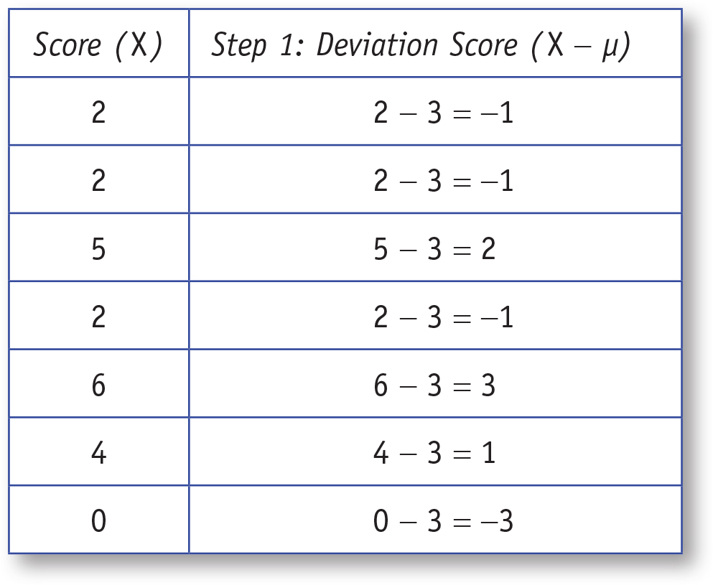
Table 3.1: Computing Deviation Scores, Step 1
Notes:
Learning Objective: Compute the variance and the standard deviation for a population using a calculator
Table 3.1. shows Step 1 of the definitional formula for SS. p. 67

Slide 8
Step 2: Square the Deviation Scores, (X − μ)2
Square each deviation score
Notes:
Learning Objective: Compute the variance and the standard deviation for a population using a calculator

Slide 9
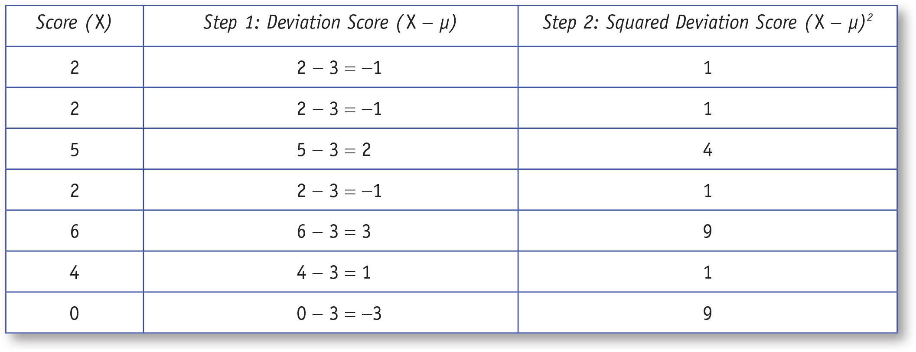
Table 3.2: Computing Deviation Scores, Step 2
Notes:
Learning Objective: Compute the variance and the standard deviation for a population using a calculator
Table 3.2. shows Steps 1 and 2 of the definitional formula for SS. p. 67

Slide 10
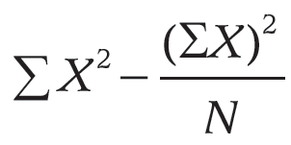
Step 3: Compute the Sum of the Squared Deviation Scores
Definitional formula SS = Σ(X − μ)2
add up the squared deviation scores
See Table 3.3
Computational formula SS =
See Table 3.4
Notes:
Learning Objective: Compute the variance and the standard deviation for a population using a calculator

Slide 11
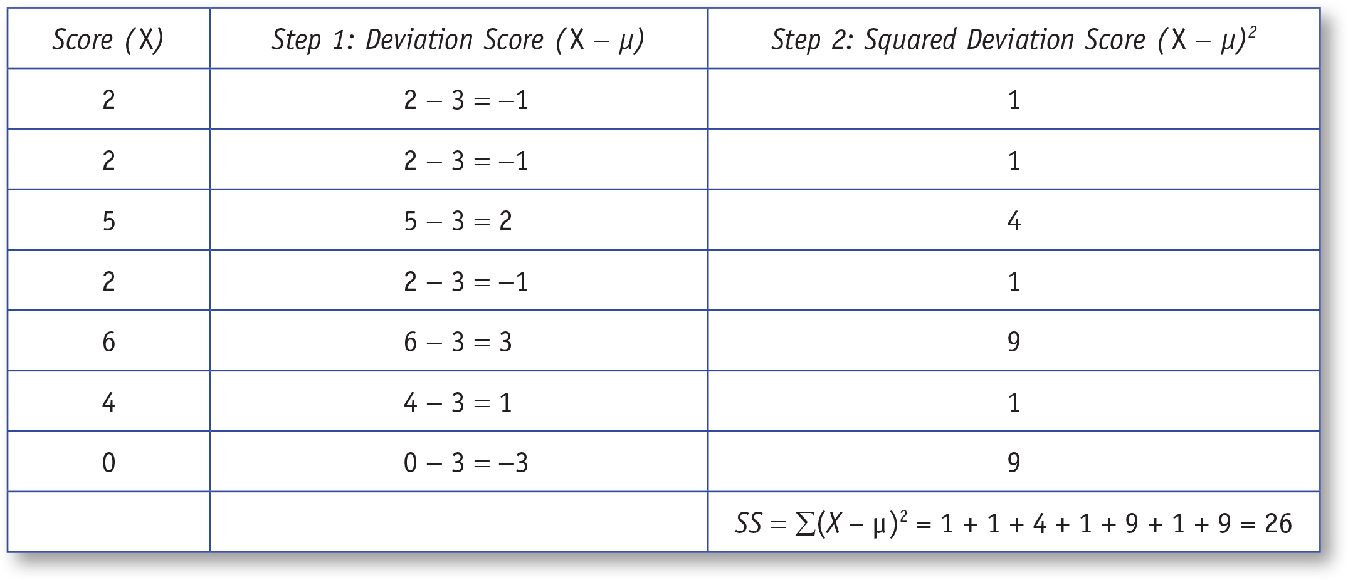
Table 3.3: Computing SS With the Definitional method, Step 3
Notes:
Learning Objective: Compute the variance and the standard deviation for a population using a calculator
Table 3.3. shows Steps 1, 2, and 3 for the definitional formula for SS. p. 68
“Our next step is to compute the sum of the squared deviation scores (SS). To compute the SS, you simply add (i.e., sum)
the squared deviation scores as was done in Table 3.3.” p. 68

Slide 12
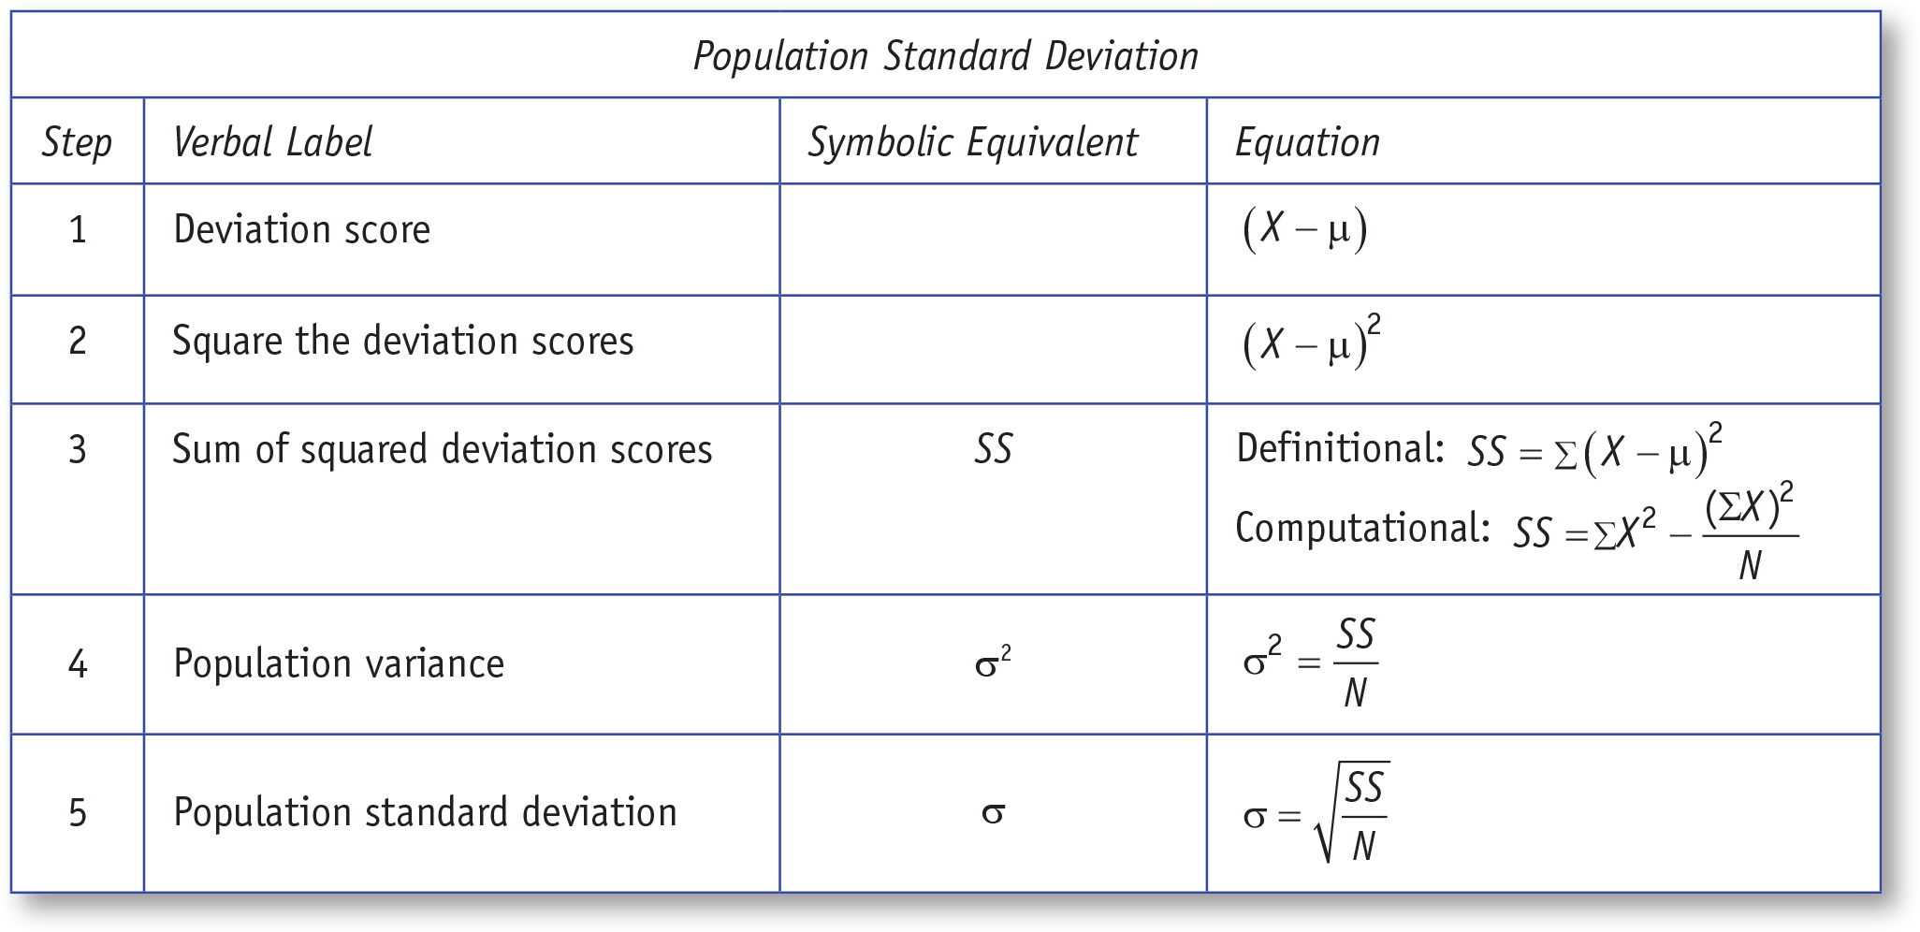
Table 3.4: Computing SS With the Computational Method
Notes:
Learning Objective: Compute the variance and the standard deviation for a population using a calculator
Table 3.4 is on p. 69
“The computational method and the definitional method will ALWAYS give you the same answer.
However, we highly recommend the computational method.” p. 68

Slide 13
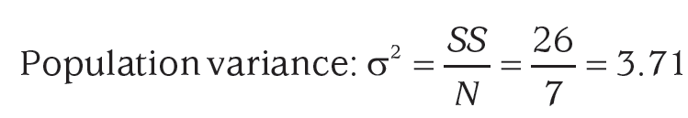
Step 4: Compute the Variance, σ2
Variance
the typical squared deviation of all the scores from the mean
divide the sum of the squared deviation scores (SS) by the number of squared deviations (N)
Notes:
Learning Objective: Compute the variance and the standard deviation for a population using a calculator
Explain the symbol for population variance is “sigma squared”, the lower case Greek letter sigma.

Slide 14
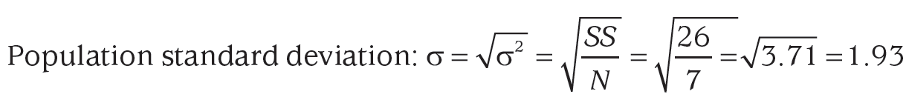
Step 5: Compute the Standard Deviation, σ
Standard deviation
the typical deviation of scores from the mean
the square root of the variance
Notes:
Learning Objective: Compute the variance and the standard deviation for a population using a calculator

Slide 15
Table 3.4: Summary of Five Steps to Computing a Population’s Standard Deviation
Notes:
Learning Objective: Compute the variance and the standard deviation for a population using a calculator
Table 3.4 is on p. 70
There appears to be two tables called Table 3.4. (This one should be called 3.5)
“The computational method and the definitional method will ALWAYS give you the same answer.
However, we highly recommend the computational method.” p. 68

Slide 16
Sample Variability
Compute the variance and the standard deviation for a sample using a calculator and SPSS
Notes:
Learning Objective: Compute the variance and the standard deviation for a population using a calculator

Slide 17
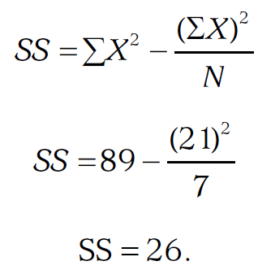
Steps 1 Through 3: Obtaining the SS
Computing the sum of the squared deviation scores (SS) is identical for a sample and population.
For scores, 2, 2, 5, 2, 6, 4, 0
SX = 21 and SX² = 89
Notes:
Learning Objective: Compute the variance and the standard deviation for a population using a calculator

Slide 18
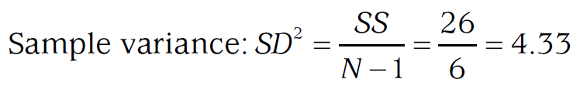
Step 4: Compute the Sample Variance,SD²
To compute the sample variance, you divide the SS by N − 1
Notes:
Learning Objective: Compute the variance and the standard deviation for a sample using a calculator and SPSS
“Why we divide by N − 1 when using a sample to estimate a population’s variability rather than by
N is a somewhat complicated issue. The simplest explanation is that samples are less variable than
populations, and without the N - 1 adjustment, our variability estimate would be too low.” p. 73

Slide 19
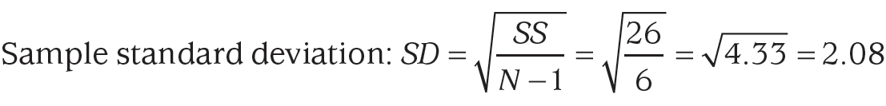
Step 5: Compute the Sample Standard Deviation, SD
Take the square root of the sample variance
Notes:
Learning Objective: Compute the variance and the standard deviation for a sample using a calculator and SPSS
“Why we divide by N − 1 when using a sample to estimate a population’s variability rather than by
N is a somewhat complicated issue. The simplest explanation is that samples are less variable than
populations, and without the N - 1 adjustment, our variability estimate would be too low.” p. 73

Slide 20
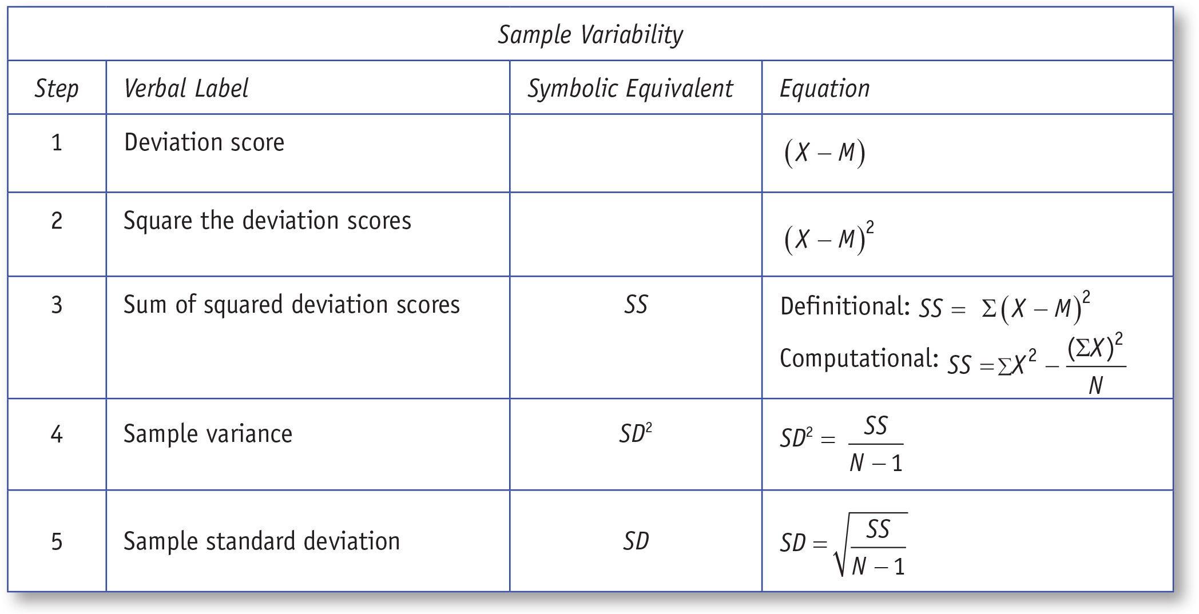
Table 3.6: Summary of Five Steps to Computing A Sample Standard Deviation.
Notes:
Learning Objective: Compute the variance and the standard deviation for a sample using a calculator and SPSS

Slide 21
SPSS
Compute the variance and the standard deviation for a sample using a calculator and SPSS
Notes:
Learning Objective: Compute the variance and the standard deviation for a sample using a calculator and SPSS

Slide 22
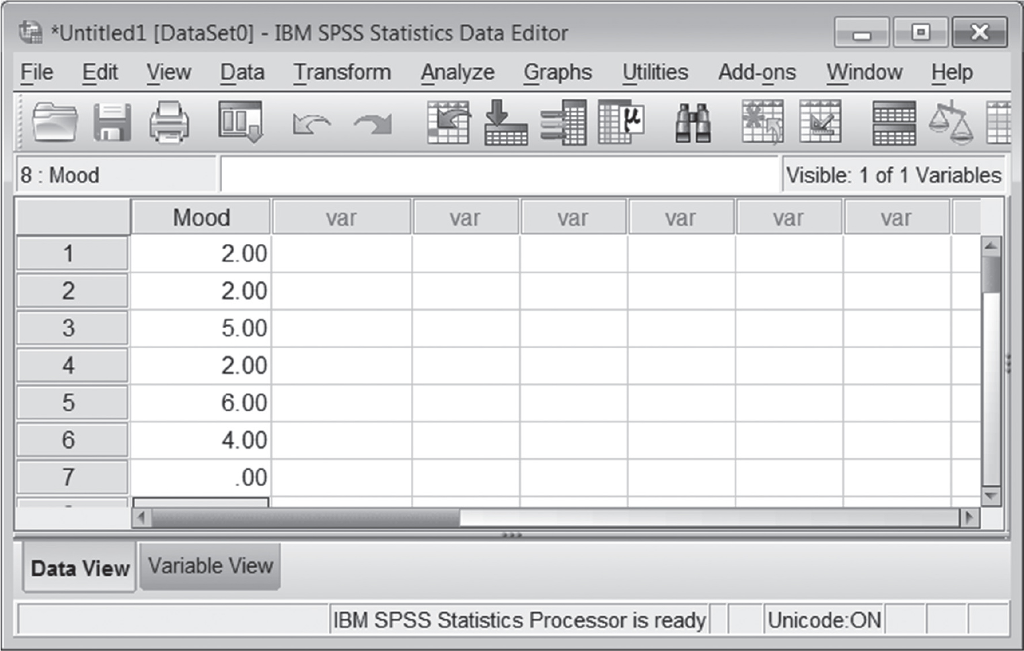
Figure 3.1: SPSS Screenshot of Data Entry Screen
Notes:
Learning Objective: Compute the variance and the standard deviation for a sample using a calculator and SPSS
“Begin by entering the sample scores (2, 2, 5, 2, 6, 4, 0) into one column in SPSS. This is what your data file should look like when it is done (Figure 3.1):” p. 75

Slide 23
Computing Measures of Variability
Click on the Analyze menu. Choose Descriptive Statistics and then Frequencies (see Figure 3.2).
Notes:
Learning Objective: Enter data into SPSS and generate frequency distribution tables and graphs
The text refers to the data from Table 1.2 about cell phones that have been entered into an SPSS data file.

Slide 24
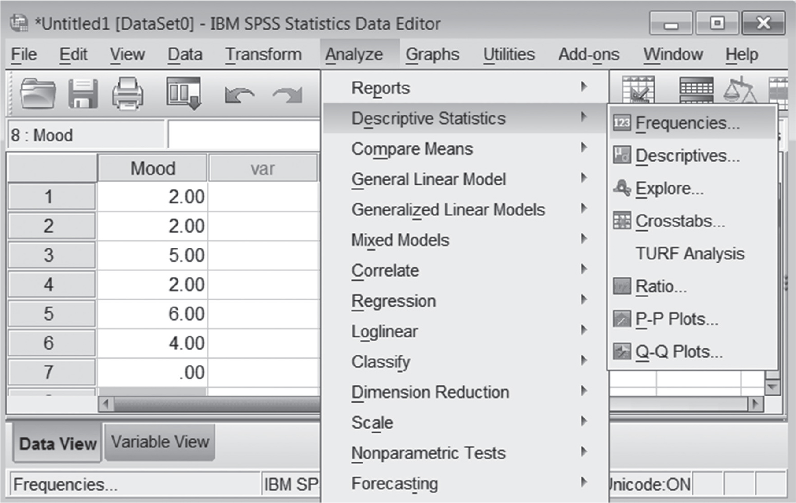
Figure 3.2: SPSS Screenshot of Analyze Menu for Measures of Variability
Notes:
Learning Objective: Compute the variance and the standard deviation for a sample using a calculator and SPSS
Analyze, Descriptive Statistics, Frequencies

Slide 25
Computing Measures of Variability
Move the variable(s) of interest into the Variable(s) box (see Figure 3.3).
Make sure the Display Frequency Tables box is unchecked if you do not want a frequency distribution table.
Click on the Statistics button.
Notes:
Learning Objective: Enter data into SPSS and generate frequency distribution tables and graphs
The text refers to the data from Table 1.2 about cell phones that have been entered into an SPSS data file.

Slide 26
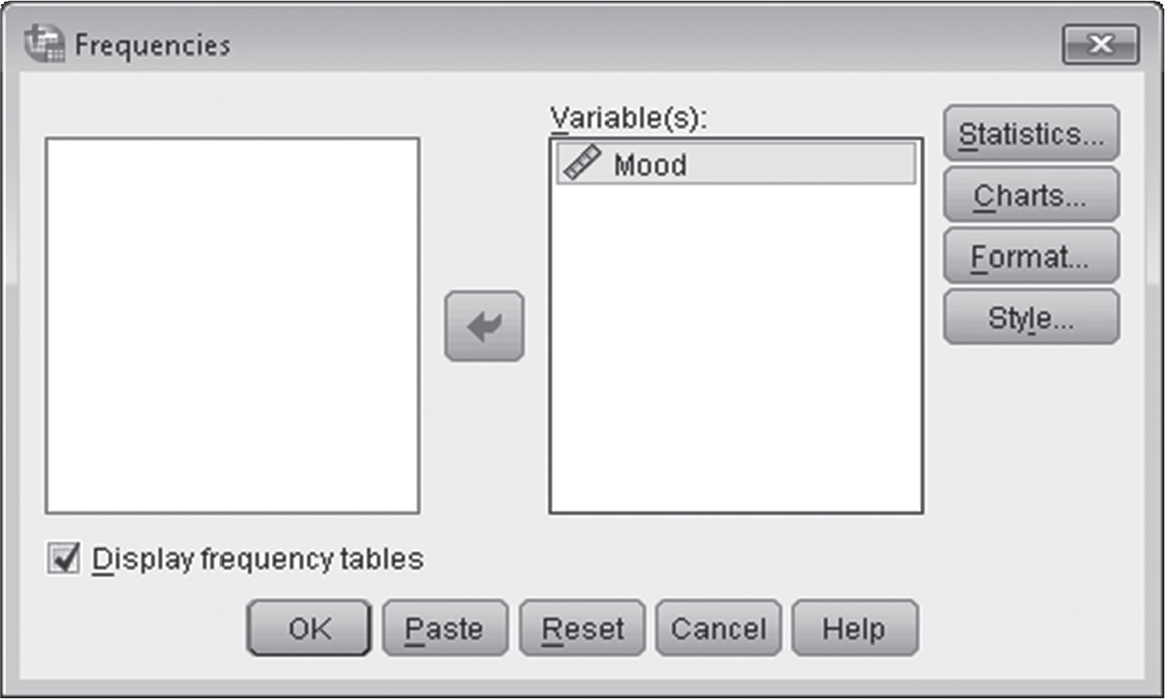
Figure 3.3: SPSS Screenshot of Choosing Variables for Analysis
Notes:
Learning Objective: Compute the variance and the standard deviation for a sample using a calculator and SPSS
“Important Note: SPSS computes the sample standard deviation and variance, not the population
values.” p. 75

Slide 27
Computing Measures of Variability
Click on the boxes for mean, standard deviation, variance, minimum, and maximum, and then
click on the Continue button, and then click OK (see Figure 3.4).
Important Note: SPSS computes the sample standard deviation and variance, not the population values.
Notes:
Learning Objective: Enter data into SPSS and generate frequency distribution tables and graphs
The text refers to the data from Table 1.2 about cell phones that have been entered into an SPSS data file.

Slide 28
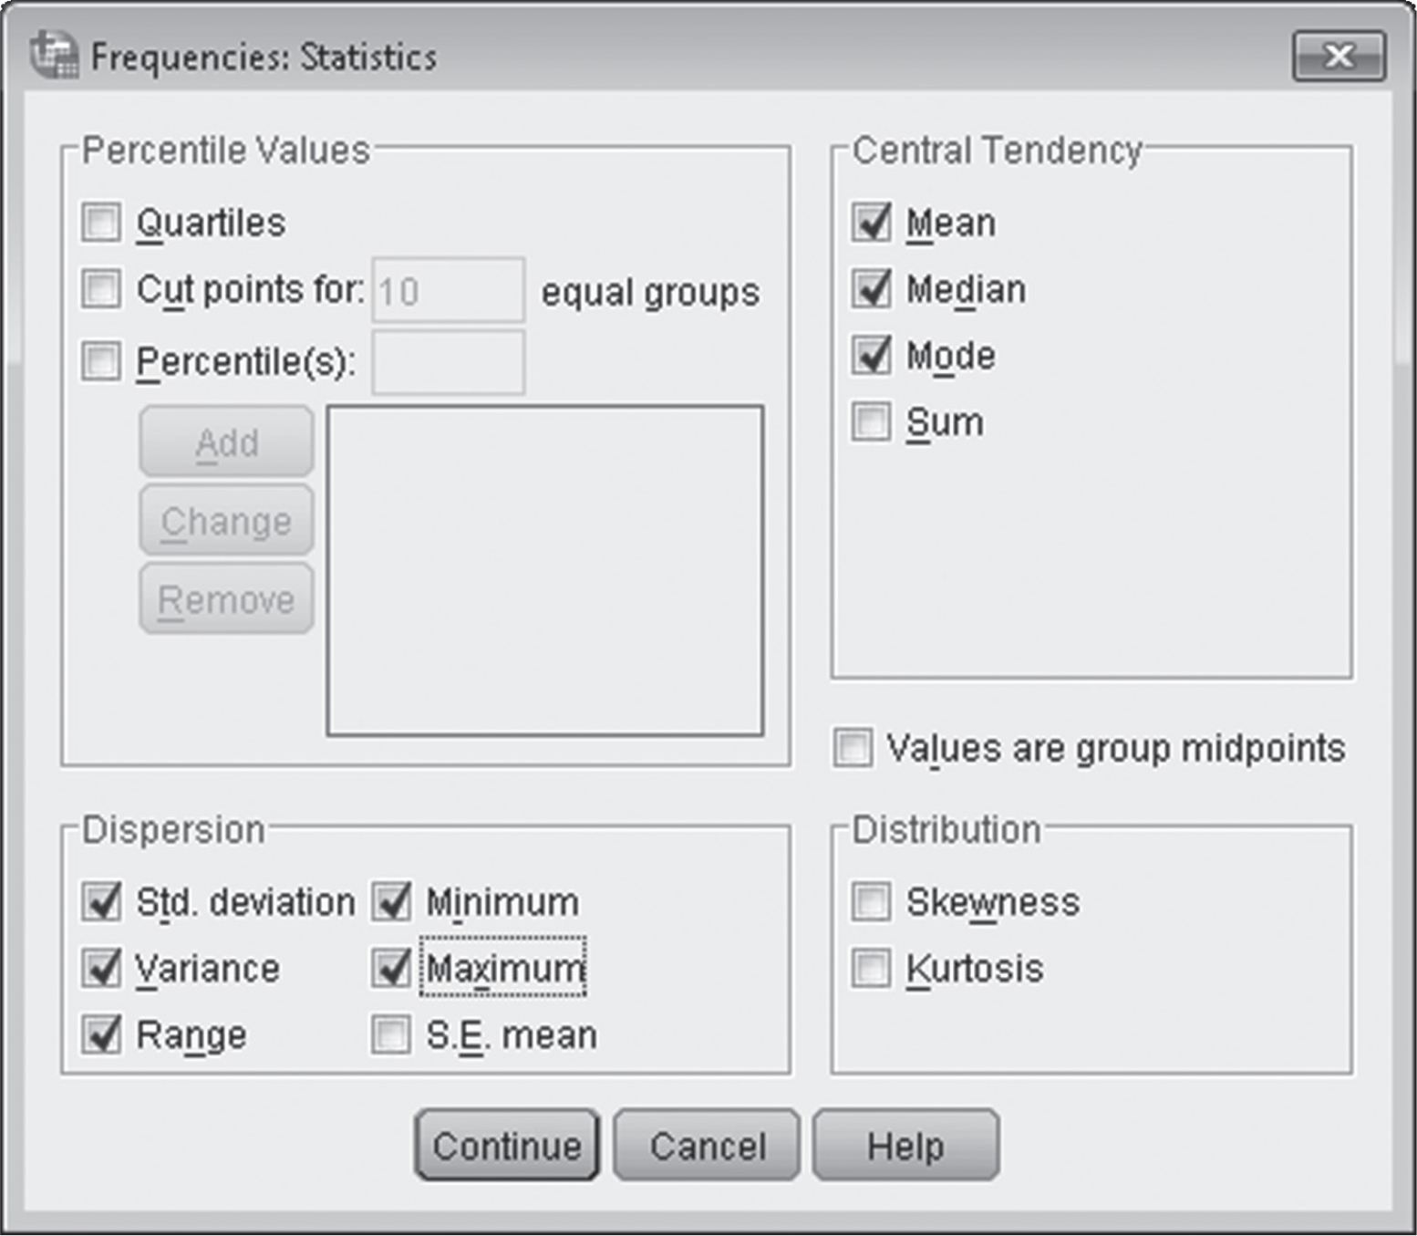
Figure 3.4: SPSS SPSS Screenshot of Selecting Descriptive Statistics
Notes:
Learning Objective: Compute the variance and the standard deviation for a sample using a calculator and SPSS
“Important Note: SPSS computes the sample standard deviation and variance, not the population
values.” p. 75

Slide 29
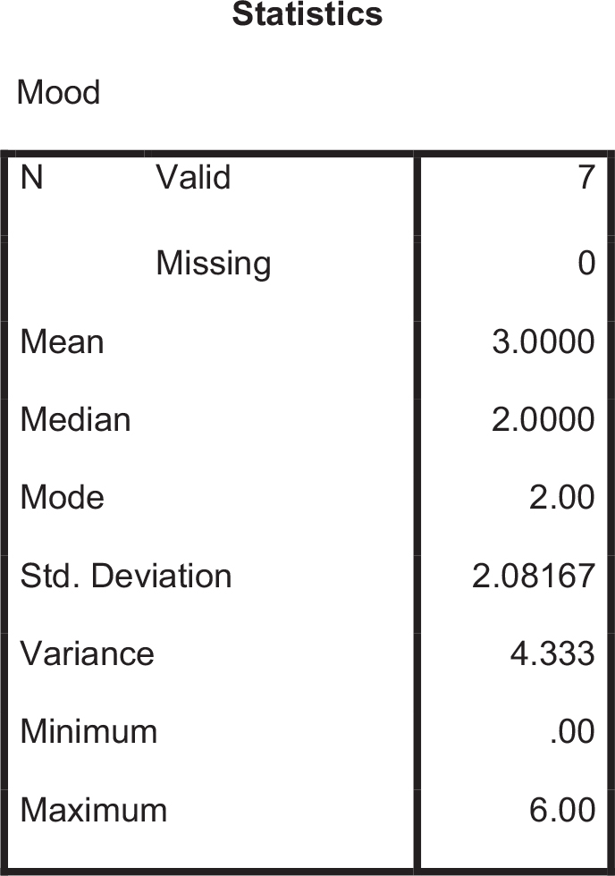
Figure 3.5: SPSS Output for Descriptive Statistics
Notes:
Learning Objective: Compute the variance and the standard deviation for a sample using a calculator and SPSS

